Slide 1
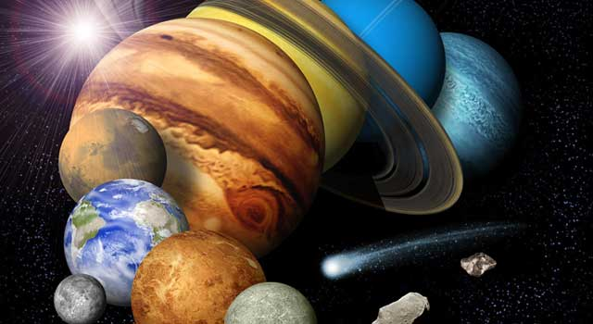

An Introduction to the PDS/PPI Website

Slide 2
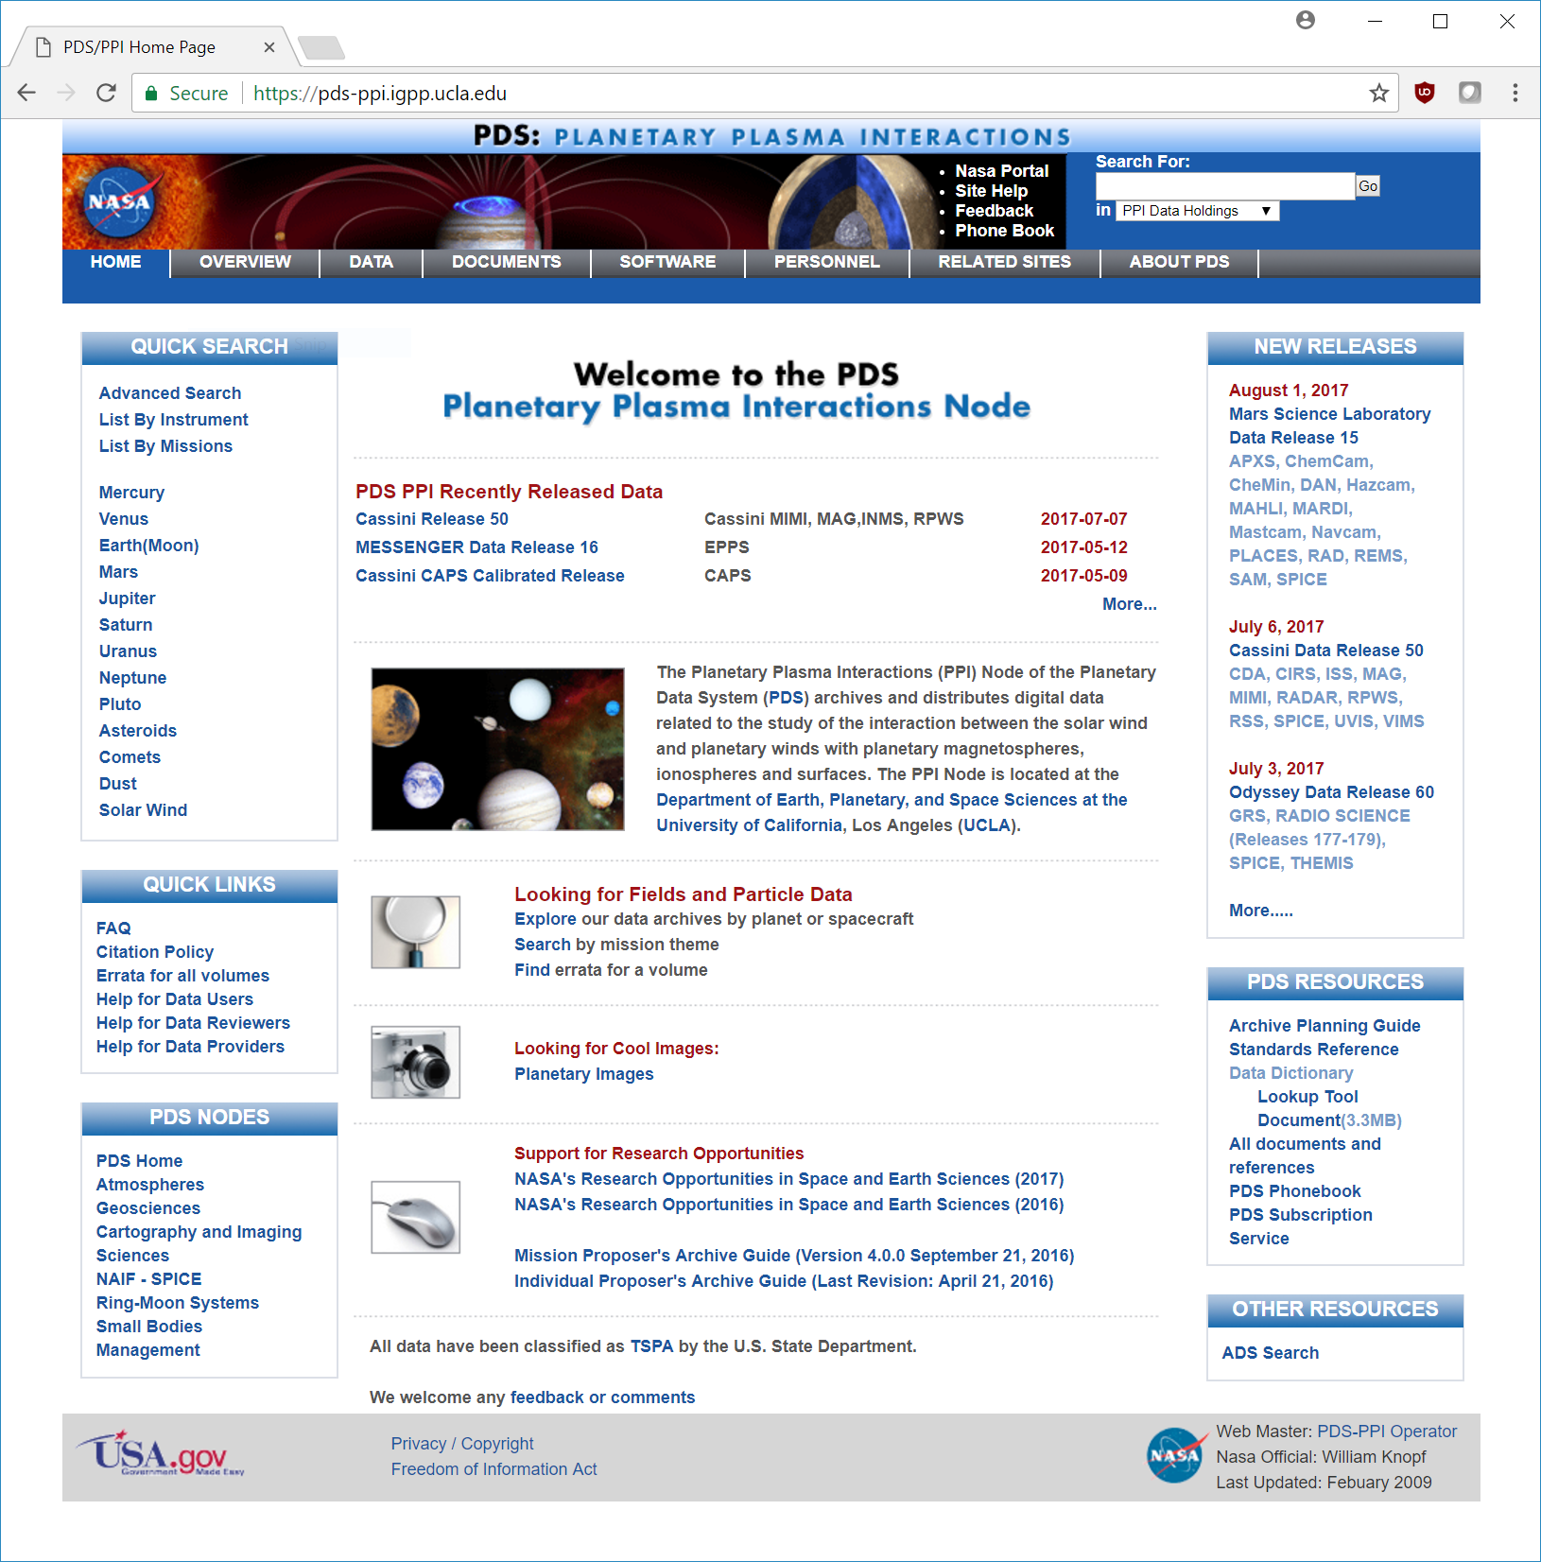
Navigation
Information
Data Discovery
Results

Slide 3
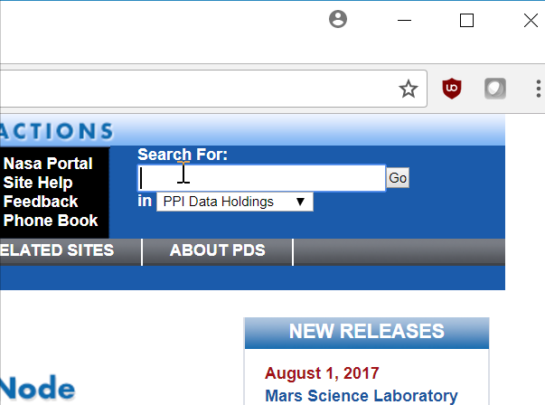

Slide 4


Slide 6
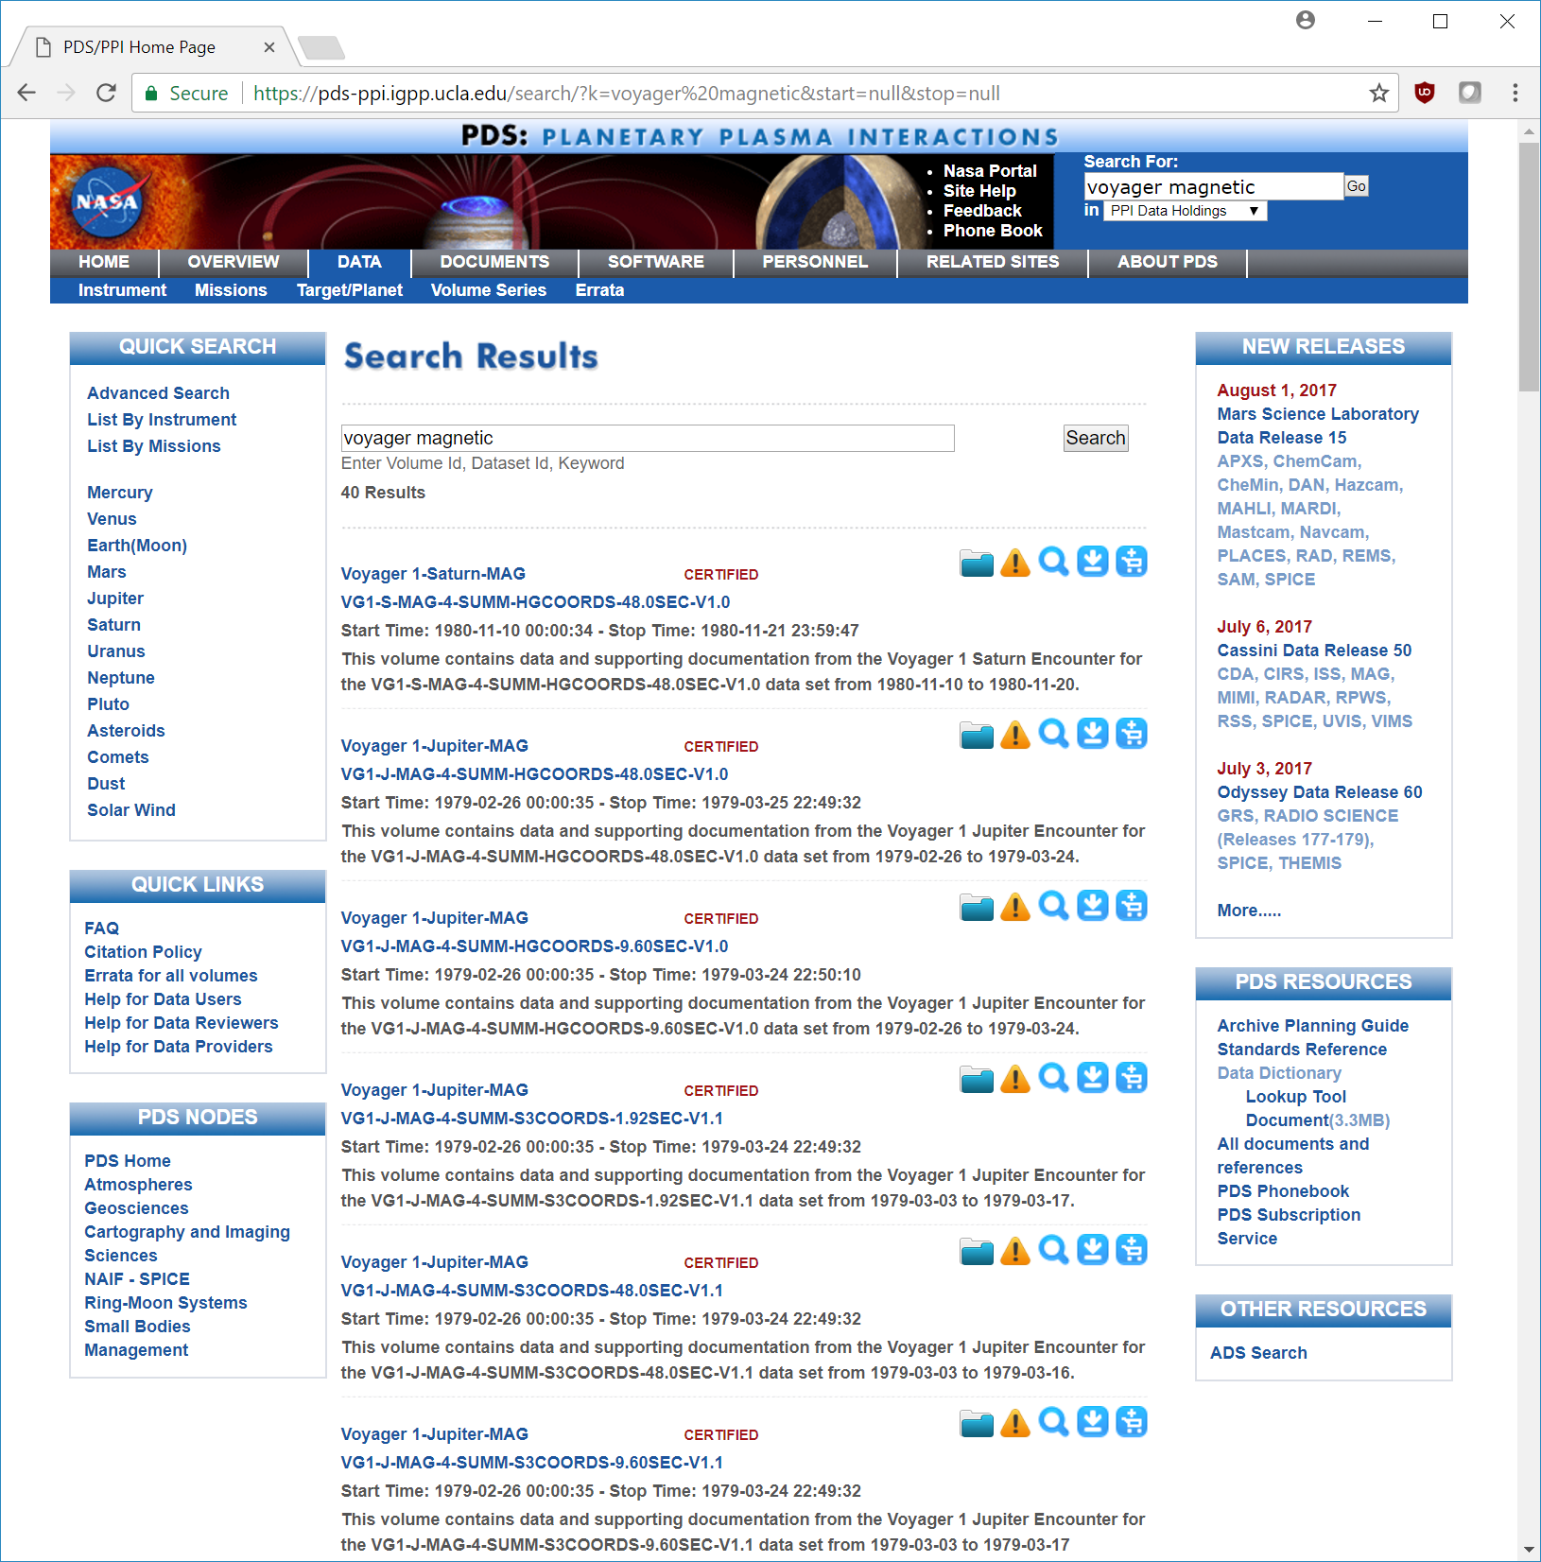





Action
Buttons
Collection
Summary
Details
Errata
Download
Readme
Order

Slide 8
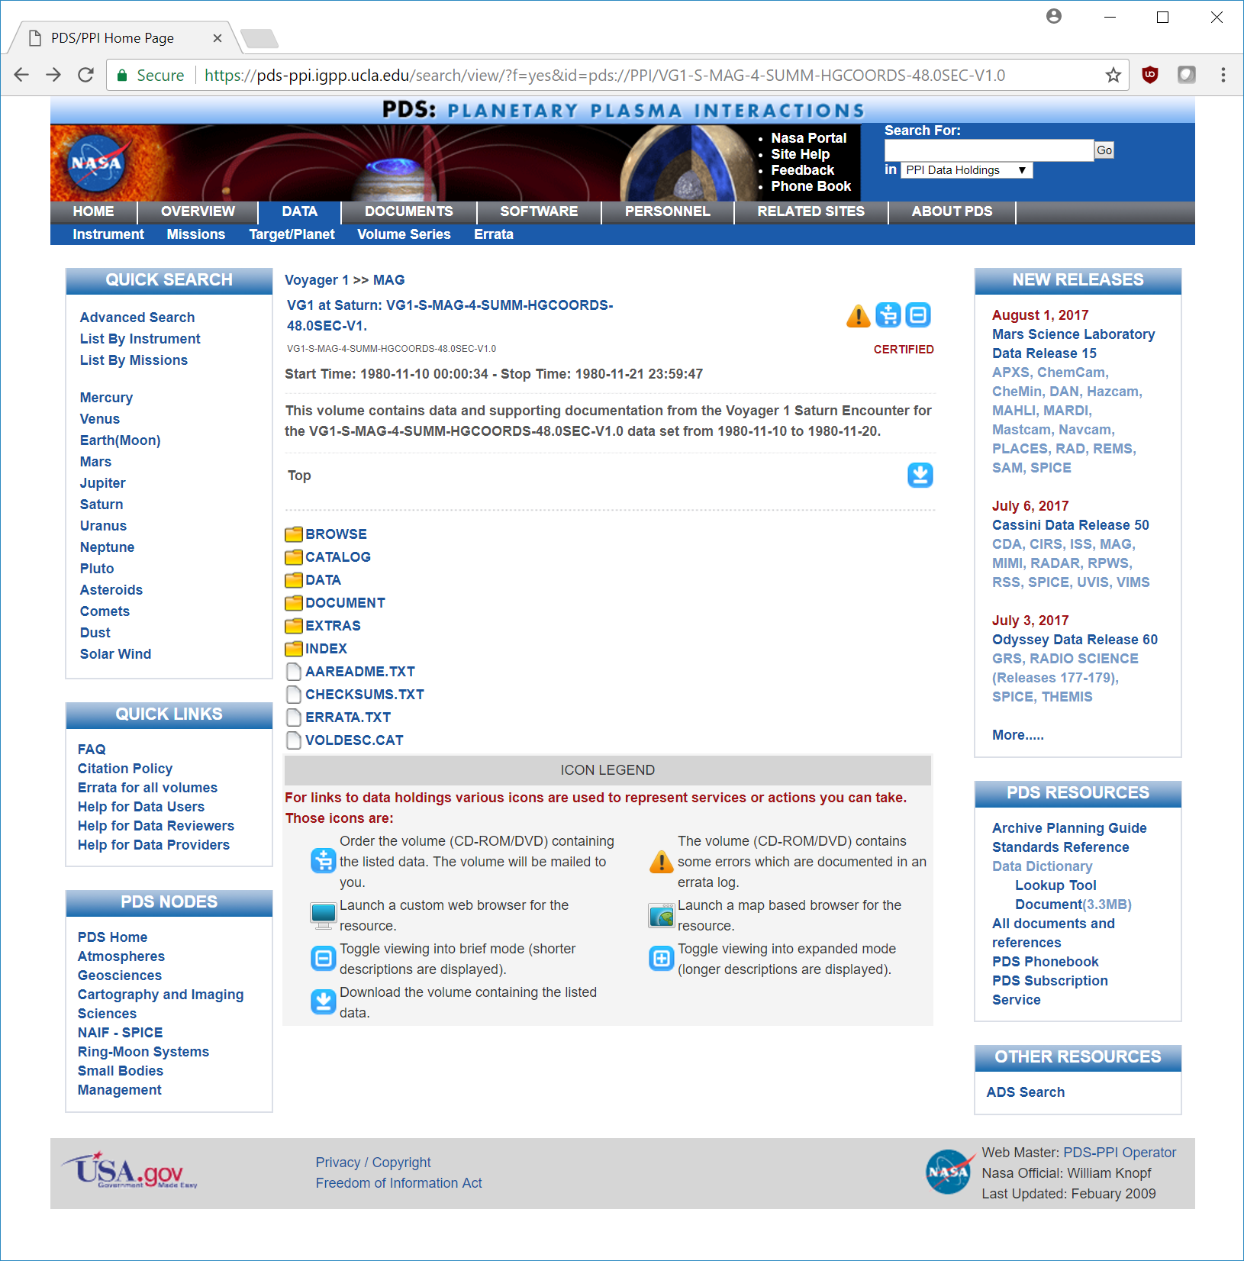
Collection
Content

Slide 9
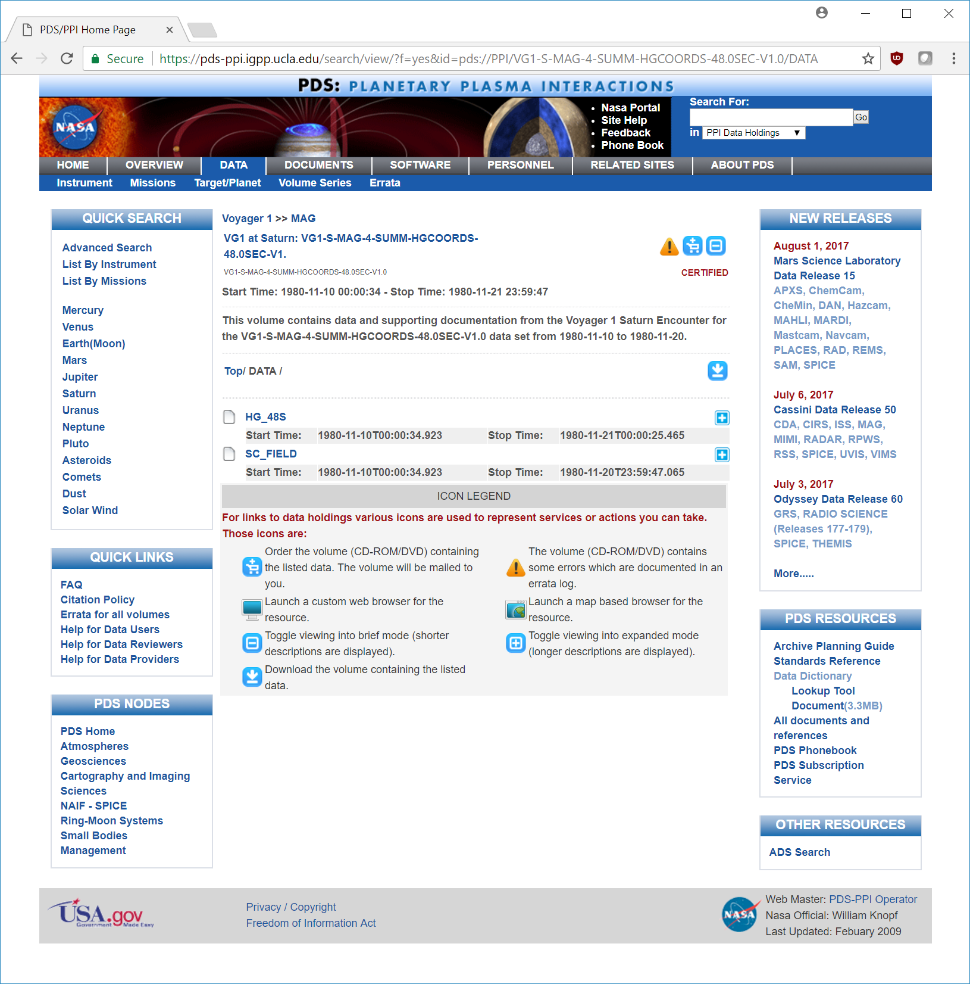
Products

Slide 10


Files
Label (metadata)
View
Data

Slide 11
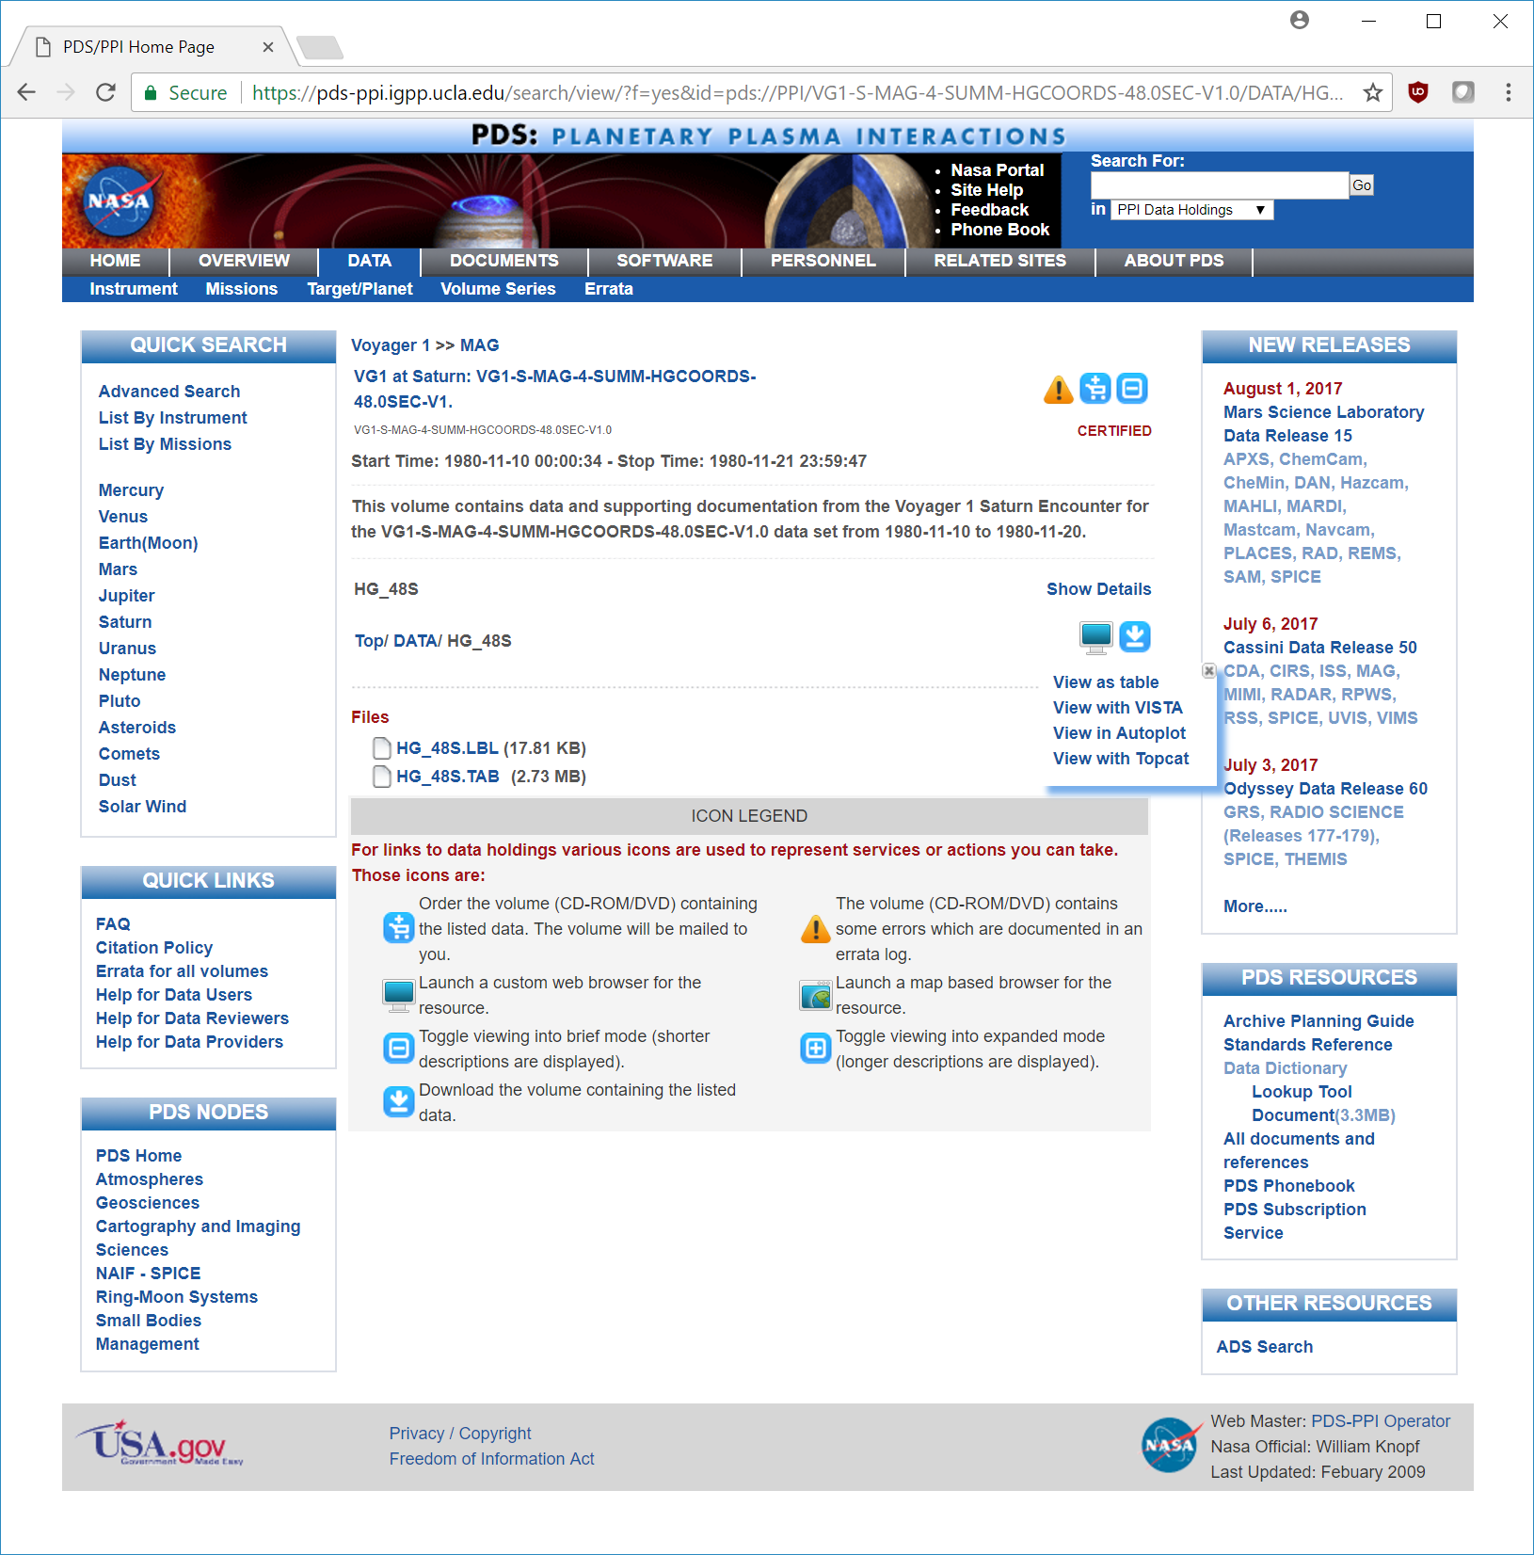
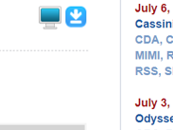

Slide 12
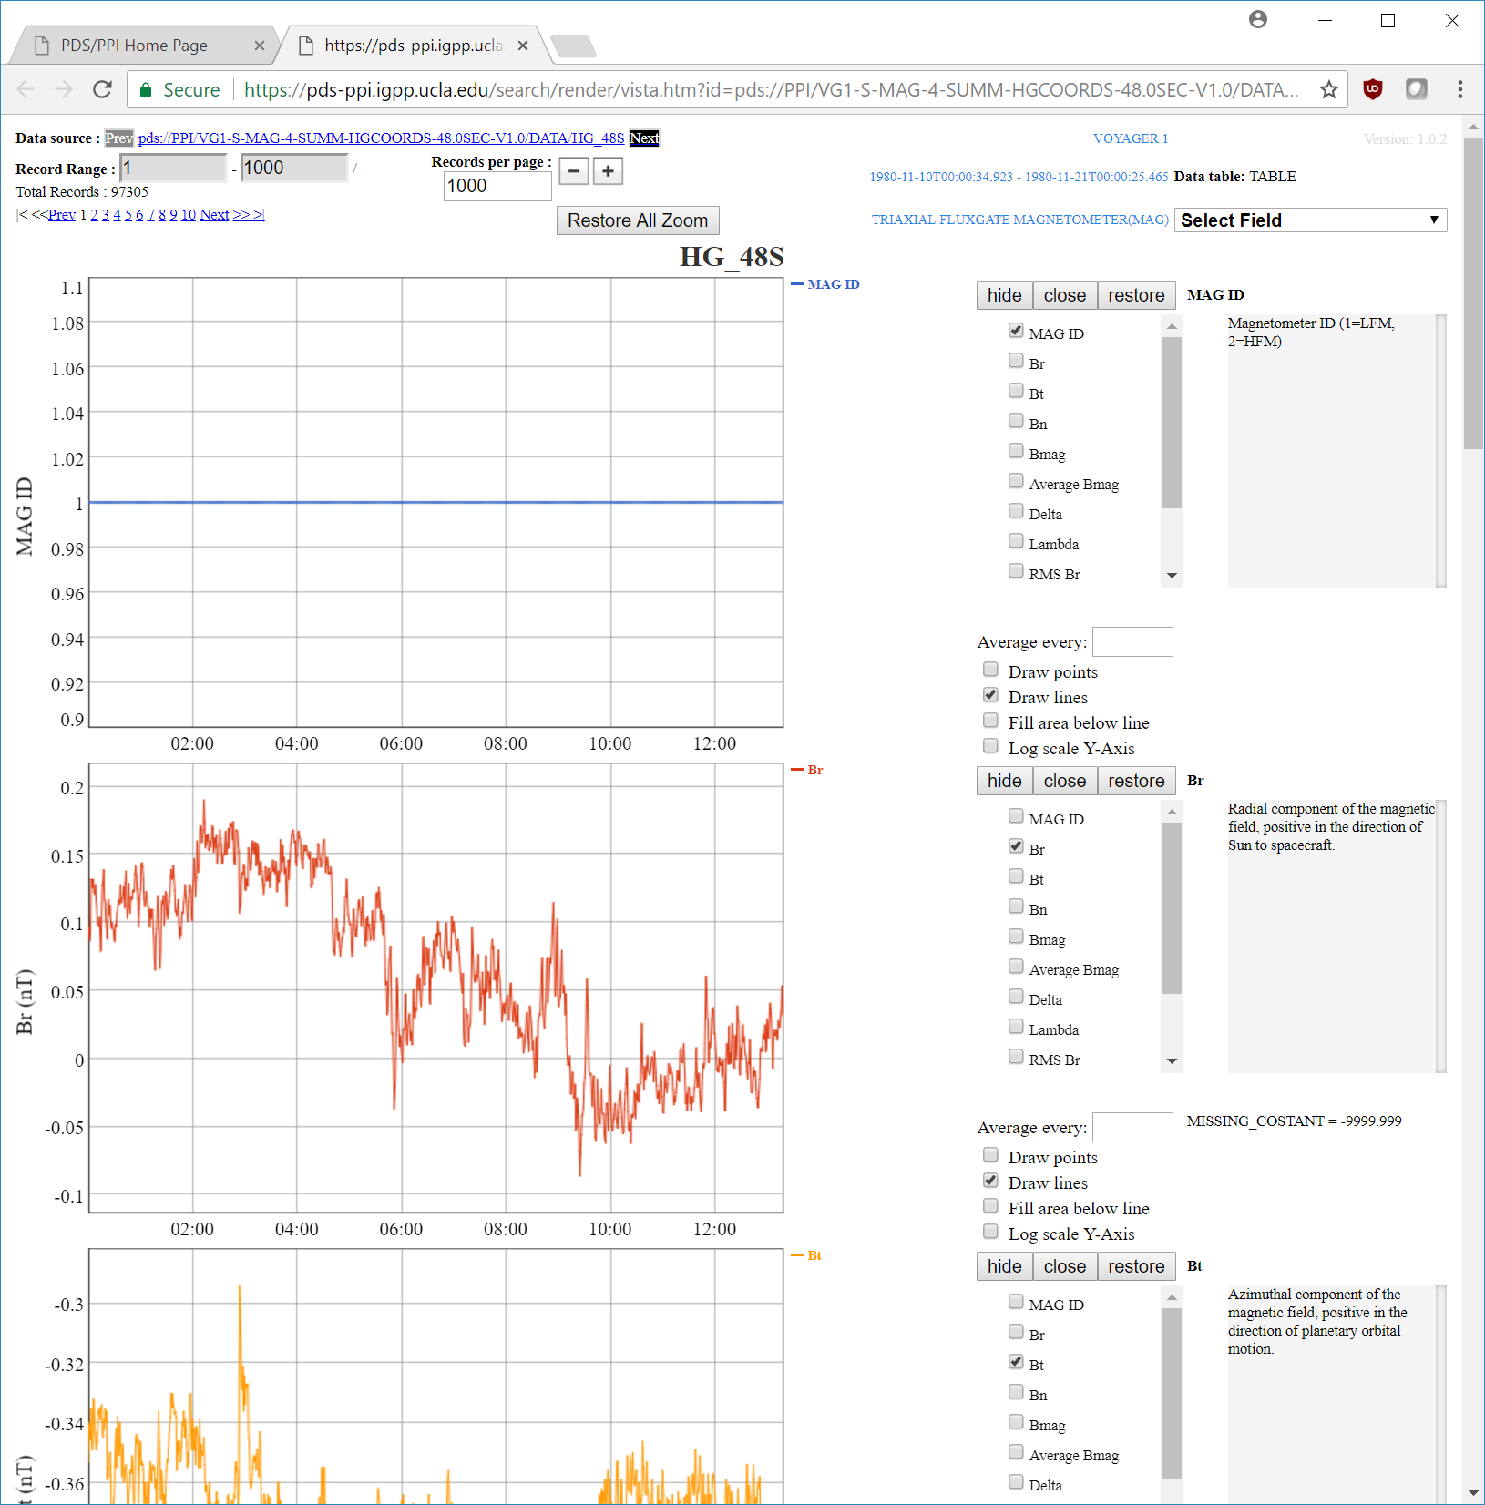
Quick view
of data with Vista

Slide 13

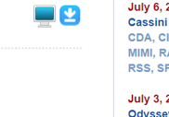

Slide 14
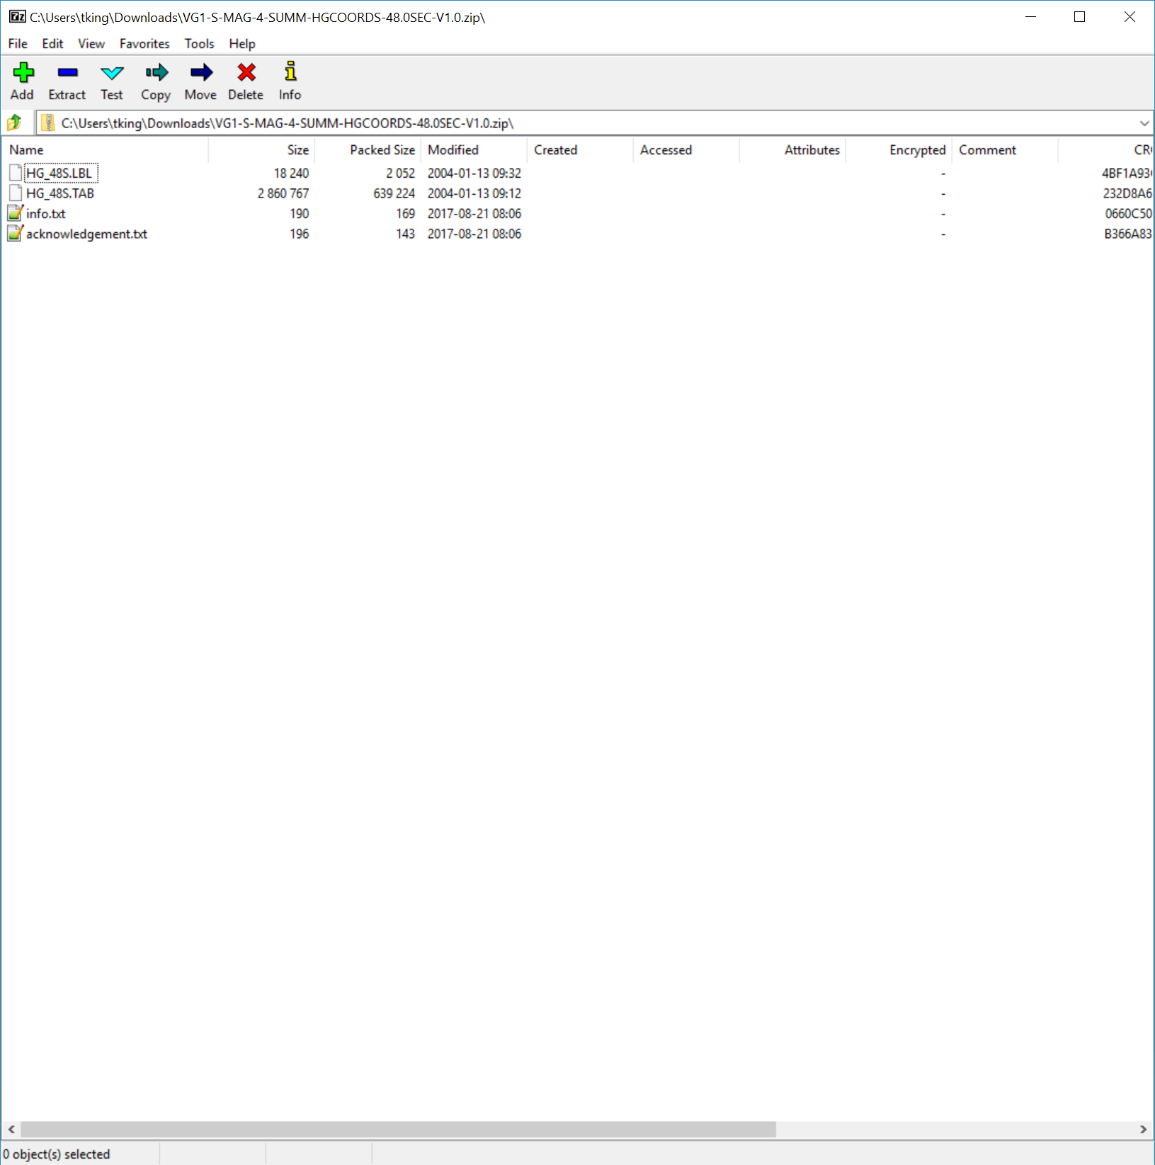
Product
Files
info.txt
Info on how to download the data again.
acknowledgement.txt Requested acknowledgement to make when using the data.
We now have the Voyager 1 magnetometer data.

Slide 15
To visit the PDS/PPI web site
https://pds-ppi.igpp.ucla.edu
For more information about PDS visit
https://pds.nasa.gov
Produced and narrated by Todd King
University of California, Los Angeles (UCLA)

